Slide 1

Enhancing Air Quality Assessment in Tennessee: A Comprehensive Analysis

Slide 2

Introduction
Welcome to the presentation on Enhancing Air Quality Assessment in Tennessee: A Comprehensive Analysis. In this presentation, we will explore the current state of air quality in Tennessee, discuss the challenges faced, and propose effective strategies for improvement.

Slide 3

Importance of Air Quality Assessment
Air quality directly impacts public health, the environment, and the economy. Accurate assessment is crucial for understanding the extent of pollution and its effects.
This slide will highlight the signiﬁcance of comprehensive air quality assessment in Tennessee.

Slide 4
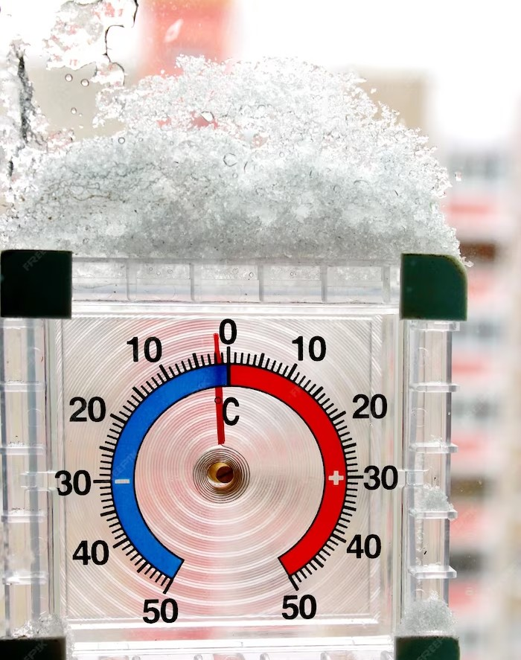
Current Air Quality Status
This slide will provide an overview of the current air quality status in Tennessee. It will highlight key pollutants, their sources, and the regions most affected. Recent data and statistics will be presented to emphasize the need for action.

Slide 5
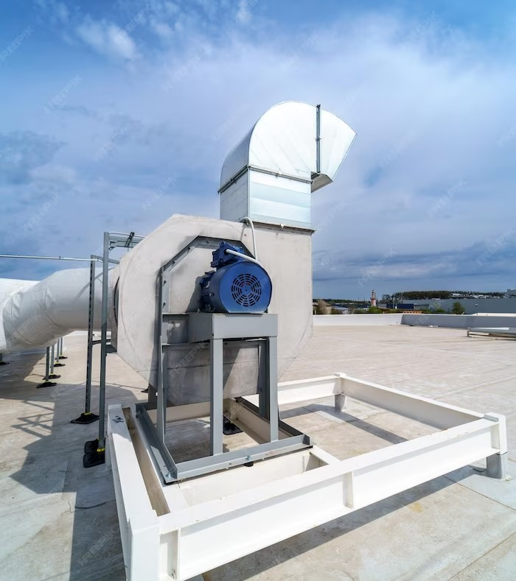
Challenges in Air Quality Assessment
Assessing air quality accurately poses several challenges. This slide will discuss the limitations of existing monitoring systems, the complexity of pollutant interactions, and the need for advanced technologies and
methodologies.

Slide 6

Proposed Strategies for Improvement
To enhance air quality assessment in Tennessee, this slide will present a range of proposed strategies. These include increased monitoring network coverage, implementation of advanced modeling techniques, and collaboration with stakeholders for effective policy implementation.

Slide 7

Beneﬁts of Enhanced Air Quality Assessment
Improving air quality assessment offers numerous beneﬁts. This slide will highlight the positive impacts on public health, the environment, and the economy. It will emphasize the potential reduction in respiratory diseases, ecosystem preservation, and attraction of clean industries.

Slide 8

Call to Action
This slide will serve as a call to action, urging stakeholders to prioritize air quality assessment enhancement in Tennessee. It will emphasize the importance of collaboration, funding allocation, and policy implementation to achieve tangible improvements.

Slide 9
Conclusion
In conclusion, enhancing air quality assessment in Tennessee is crucial for a healthier and sustainable future. By addressing the challenges, implementing proposed strategies, and fostering collaboration, we can make signiﬁcant progress in ensuring cleaner air for all Tennesseans.

Slide 10
Thanks!
Do you have any questions? addyouremail@freepik.com
+91 620 421 838
yourcompany.com

